Slide 1
Name of Course: Engineering Mechanics
Course code: 216U06C104
Module 5: Kinetics of particles
Newton’s Law of Motion

Slide 2
Syllabus: Module 5
5.1 Force and acceleration: Introduction to basic concepts, equations of dynamic equilibrium, Newton’s second law of motion (only rectilinear motion).
5.2 Work energy principle.
5.3 Impulse and Momentum: Principle of linear impulse and momentum, law of conservation of momentum, impact and collision, direct central and oblique central impact

Slide 3
Learning Outcomes
At the end of lecture learner will be able to apply Newton’s second law of motion to solve numerical.

Slide 4
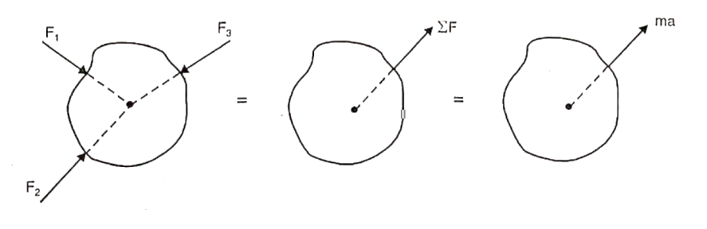
Newton’s second law motion
Statement: The rate of change of momentum of a body is directly proportional to the resultant force and takes place in the direction of the force
Fig. 1 Forces acting at a point for a body^{[2]}

Slide 5
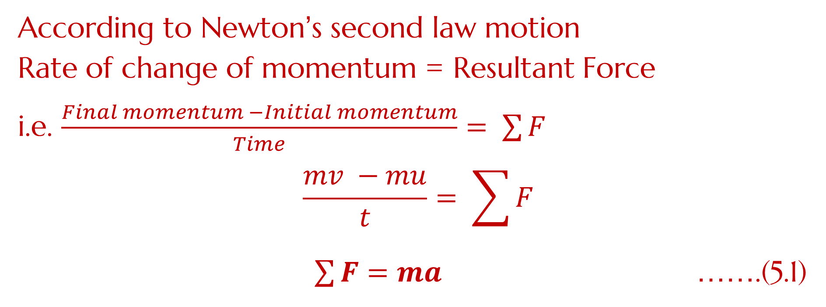
Newton’s second law motion
According to Newton’s second law motion
Rate of change of momentum = Resultant Force
i.e. $\frac{Final momentum −Initial momentum}{Time}= \sum{F}$
$$\frac{mv −mu}{t}= \sum{F}$$
$\sum{F=ma}$ …….(5.1)
Fig. 1 Forces acting at a point for a body^{[2]}

Slide 6
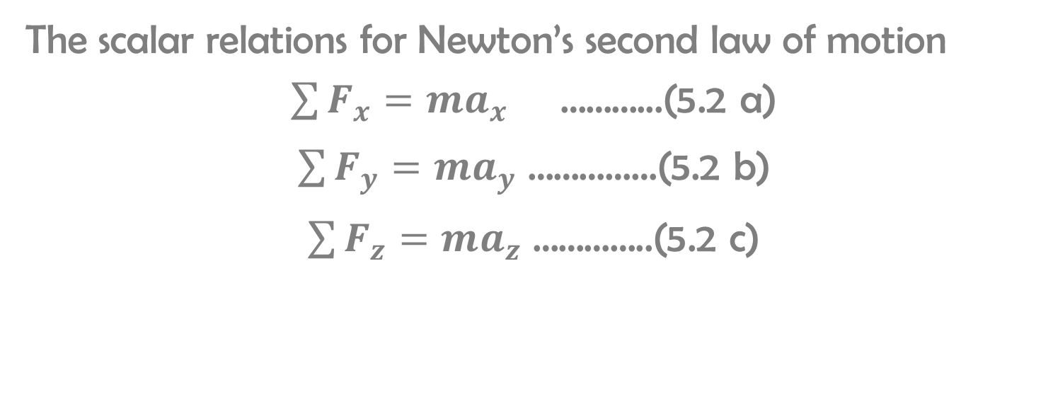
Newton’s second law motion
The scalar relations for Newton’s second law of motion
$\sum{F_{x}=ma_{x}}$ ………...(5.2 a)
$\sum{F_{y}=ma_{y}}$ ……………(5.2 b)
$\sum{F_{z}=ma_{z}}$ …………..(5.2 c)

Slide 7
Newton’s second law motion
D’Alembert’s Principle:
If the equation ΣF=ma is rearranged as
ΣF−ma=0,
treating the “– ma” as an inertia force, the system can be considered to be in dynamic equilibrium.

Slide 8
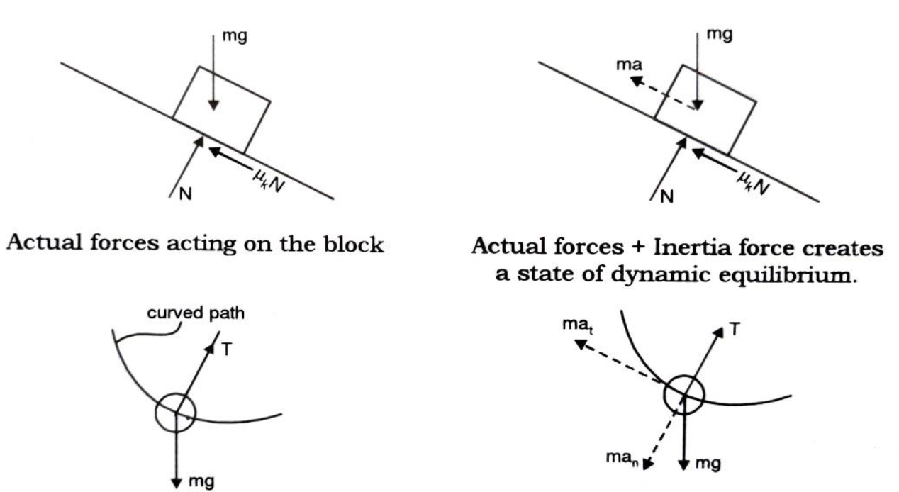

Slide 9
Numerical on Newton’s second law of motion
Q. 1) A motorist travelling at a speed of 90 kmph suddenly applies the brakes and comes to rest after skidding 100 m. Determine the time required for the car to stop and coefficient of friction μ_{k} between the tyres and the road.^{[2]}

Slide 10
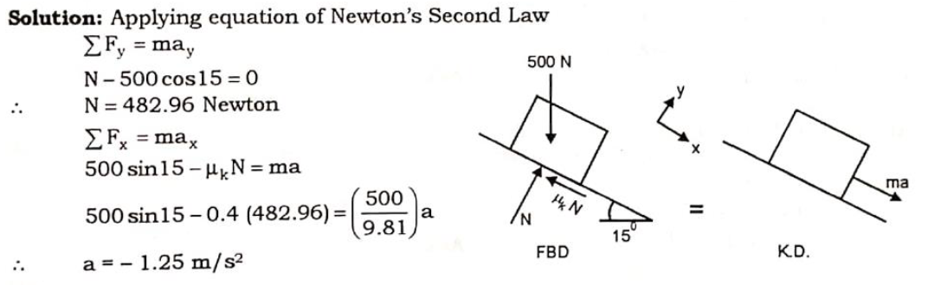
Numerical on Newton’s second law of motion
Q. 2) A 500 N crate kept on the top of a 15⁰ sloping surface is pushed down the plane with an initial velocity of 20 m/s. If μ_{s} =0.5 and μ_{k =} 0.4. Determine the distance traveled by the block and the time it will take as it comes to rest. ^{[2]}

Slide 11
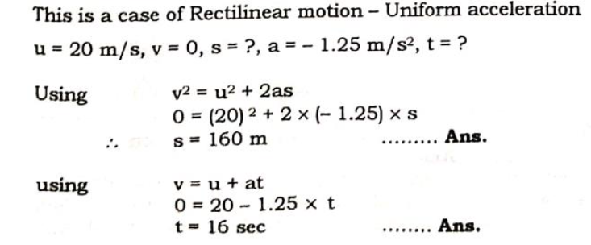
Q. 2) A 500 N crate kept on the top of a 150 sloping surface is pushed down the plane with an initial velocity of 20 m/s. If μs =0.5 and μk = 0.4. Determine the distance traveled by the block and the time it will take as it comes to rest. [2]

Slide 12
Numerical on Newton’s second law of motion
Q. 3) An elevator with a person inside, of total mass 500 kg starts moving upwards at a constant acceleration and attains a velocity of 3 m/s after traveling a distance of 3 m.
Determine :
i ) The tension in the cable
ii) If after attaining the velocity of 3 m/s the elevator stops in 2.5 seconds. Determine the pressure exerted by the elevator to the person weighing 600 N in the elevator.

Slide 13
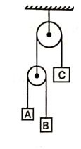
Numerical on Newton’s second law of motion
Q. 4) Three blocks A, B and C masses are 3 kg, 2 kg and 7 kg respectively are connected as shown. Determine the accelerations of A, B and C. Also determine the tension in the strings.^{[2]}
Fig. 2 pulley supporting the loads suspended from a support^{[2]}

Slide 14
References
Engineering Mechanics, N. H. Dubey, Mc Graw Hill Education (India) Pvt. Ltd.
Engineering Mechanics, M. D. Dayal, page no. 41 to 55.

Slide 15


Name of Course: Engineering Mechanics
Course code: 216U06C104
Module 5: Kinetics of particles
Lecture : Work energy Principle

Slide 16
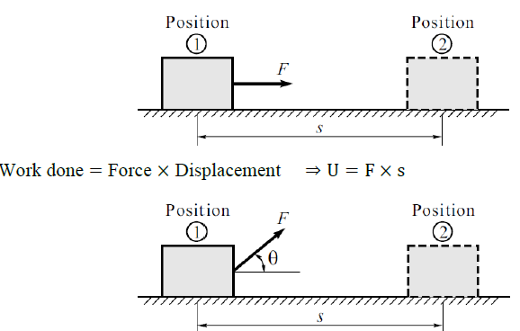
Work: It is defined as the product of the displacement and the force in the direction of the displacement.

Slide 17
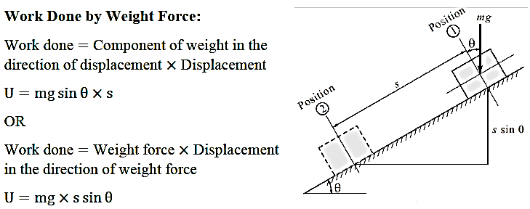
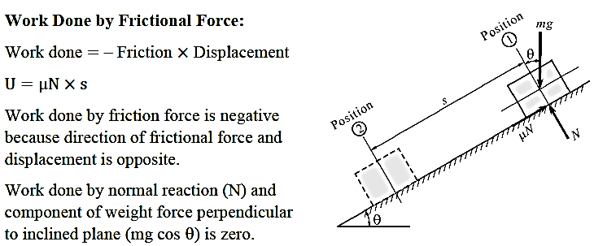

Slide 18
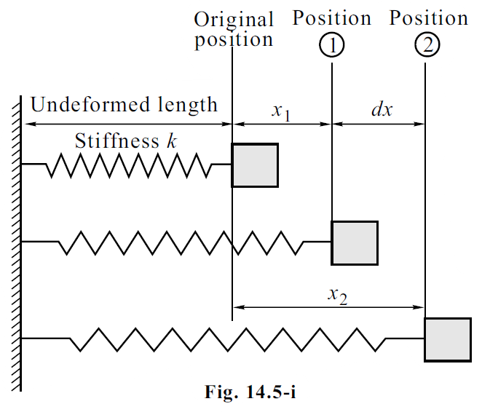
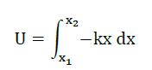
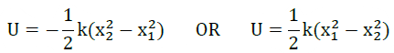
Work Done by Spring Force:
Consider a spring of stiffness k as shown in the figure, with some undeformed (free/original) length. Let x1 & x2 be deformations of spring at positions 1 & 2.
Work done = Spring force × Deformation
∴ Spring force F = −k × x
where k is the spring stiffness (N/m) x is the deformation of spring (m) – ve sign indicates direction of spring force acting towards original position.

Slide 19
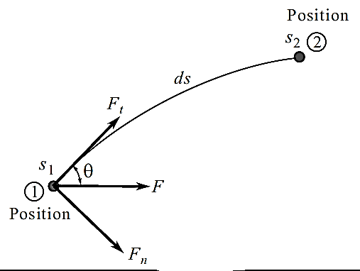
Kinetic Energy: It is the energy possessed by a particle by virtue of its motion. K.E.=1/2*mv²
Potential Energy: It is the energy possessed by a particle by virtue of its position.
P.E.=+mgh, if displacement is downwards
P.E.=−mgh, if displacement is upwards
Work Energy Principle:
Work done by the forces acting on a particle during some displacement is equal to the change in kinetic energy during that displacement.

Slide 20
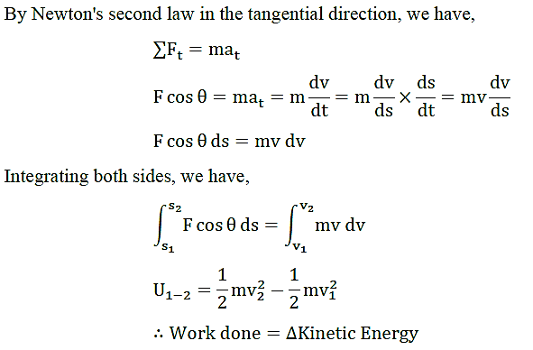
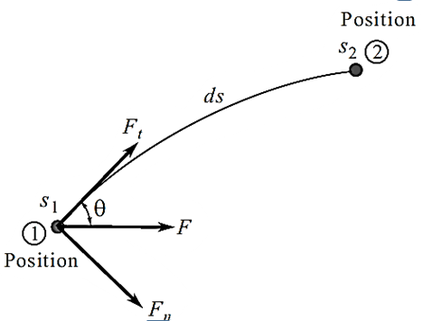

Slide 21
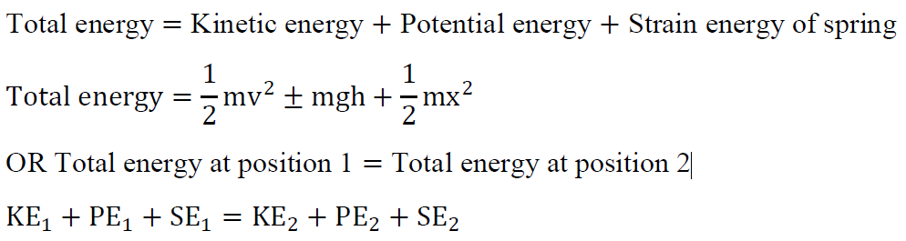
Principle of Conservation of Energy:
Conservative Forces: If the work of a force is moving a particle between two positions is independent of the path followed by the particle and can be expressed as a change in its potential energy, then such forces is called as conservative forces. E.g., weight force of particle (gravity force), spring force and elastic force.
Non-Conservative Forces: The forces in which the work is dependent upon the path followed by the particles is known as non-conservative forces. E.g., frictional force
When a particle is moving from position 1 to position 2 under the action of only conservative forces (i.e., when frictional force does not exist) then by energy conservation principle we say that the total energy remains constant.

Slide 22
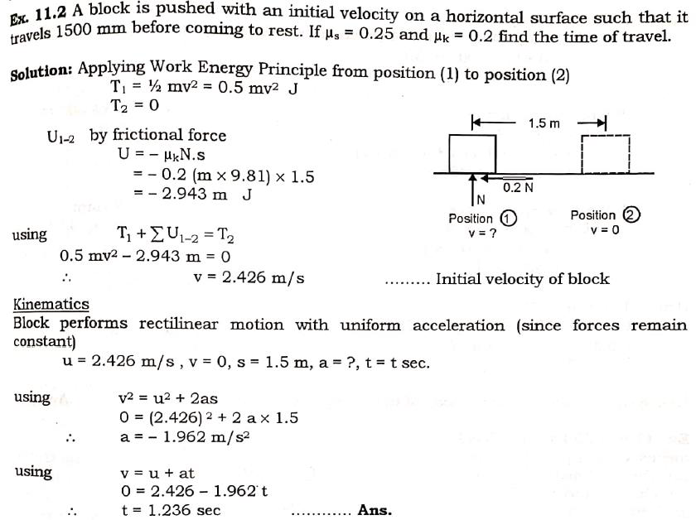

Slide 23
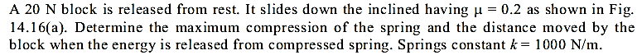
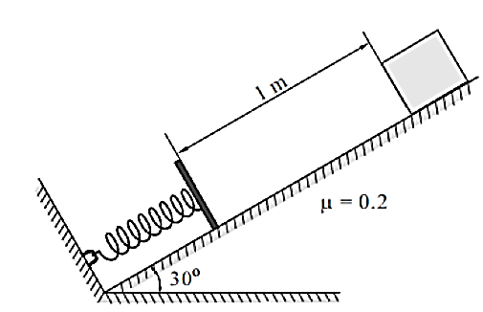
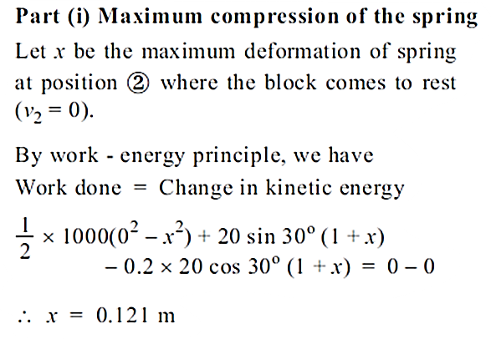
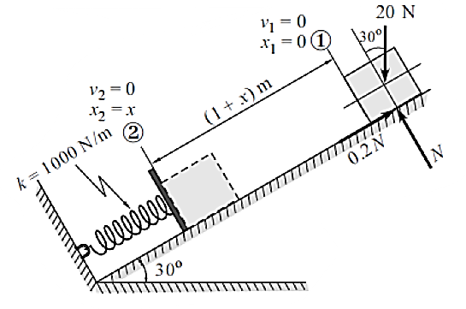

Slide 24
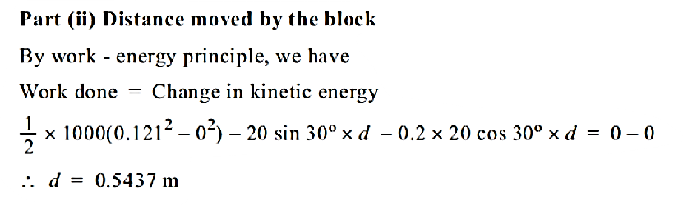
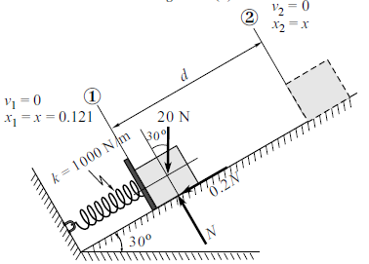

Slide 25
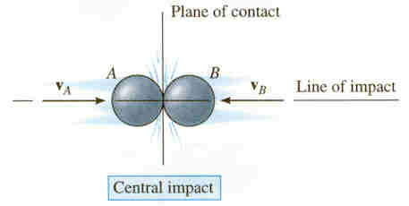
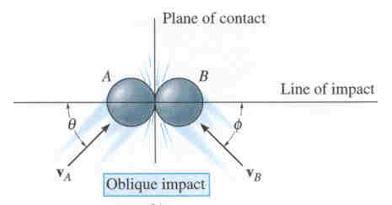
Impact
Impact occurs when two bodies collide during a very short time period, causing large impulsive forces to be exerted between the bodies. Common examples of impact are a hammer striking a nail or a bat striking a ball. The line of impact is a line through the mass centers of the colliding particles. In general, there are two types of impact:
Central impact occurs when the directions of motion of the two colliding particles are along the line of impact.
Oblique impact occurs when the direction of motion of one or both of the particles is at an angle to the line of impact.

Slide 26
Central impact
Central impact happens when the velocities of the two objects are along the line of impact (recall that the line of impact is a line through the particles’ mass centers).
v_{A}
v_{B}
Line of impact
Once the particles contact, they may deform if they are non-rigid. In any case, energy is transferred between the two particles.
There are two primary equations used when solving impact problems. The textbook provides extensive detail on their derivation.

Slide 27
Central impact (continued)
In most problems, the initial velocities of the particles, (v_{A})₁ and (v_{B})₁, are known, and it is necessary to determine the final velocities, (v_{A})₂ and (v_{B})₂. So the first equation used is the conservation of linear momentum, applied along the line of impact.
(m_{A} v_{A})₁ + (m_{B} v_{B})₁ = (m_{A} v_{A})₂ + (m_{B} v_{B})₂
This provides one equation, but there are usually two unknowns, (v_{A})₂ and (v_{B})₂. So another equation is needed. The principle of impulse and momentum is used to develop this equation, which involves the coefficient of restitution, or e.

Slide 28
Central impact (continued)
The coefficient of restitution, e, is the ratio of the particles’ relative separation velocity after impact, (v_{B})₂ – (v_{A})₂, to the particles’ relative approach velocity before impact, (v_{A})₁ – (v_{B})₁. The coefficient of restitution is also an indicator of the energy lost during the impact.
The equation defining the coefficient of restitution, e, is
(v_{B})₂ – (v_{A})₂
e =
(v_{A})₁ - (v_{B})₁
If a value for e is specified, this relation provides the second equation necessary to solve for (v_{A})₂ and (v_{B})₂.

Slide 29
Coefficient of restitution
In general, e has a value between zero and one. The two limiting conditions can be considered:
• Elastic impact (e = 1): In a perfectly elastic collision, no energy is lost and the relative separation velocity equals the relative approach velocity of the particles. In practical situations, this condition cannot be achieved.
• Plastic impact (e = 0): In a plastic impact, the relative separation velocity is zero. The particles stick together and move with a common velocity after the impact.
Some typical values of e are:
Steel on steel: 0.5 – 0.8 Wood on wood: 0.4 – 0.6
Lead on lead: 0.12 – 0.18 Glass on glass: 0.93 – 0.95

Slide 30
Impact: Energy losses
Once the particles’ velocities before and after the collision have been determined, the energy loss during the collision can be calculated on the basis of the difference in the particles’ kinetic energy. The energy loss is
∑ U₁₋₂ = ∑ T₂ - ∑ T₁ where T_{i} = 0.5m_{i}(v_{i})²
During a collision, some of the particles’ initial kinetic energy will be lost in the form of heat, sound, or due to localized deformation.
In a plastic collision (e = 0), the energy lost is a maximum, although it does not necessarily go to zero.

Slide 31
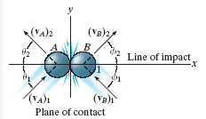
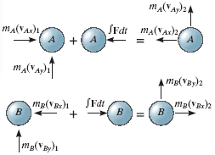
Oblique impact
In an oblique impact, one or both of the particles’ motion is at an angle to the line of impact. Typically, there will be four unknowns: the magnitudes and directions of the final velocities.
The four equations required to solve for the unknowns are:
Conservation of momentum and the coefficient of restitution equation are applied along the line of impact (x-axis):
m_{A}(v_{Ax})₁ + m_{B}(v_{Bx})₁ = m_{A}(v_{Ax})₂ + m_{B}(v_{Bx})₂
e = [(v_{Bx})₂ – (v_{Ax})₂]/[(v_{Ax})₁ – (v_{Bx})₁]
Momentum of each particle is conserved in the direction perpendicular to the line of impact (y-axis):
m_{A}(v_{Ay})₁ = m_{A}(v_{Ay})₂ and m_{B}(v_{By})₁ = m_{B}(v_{By})₂

Slide 32
Procedure of analysis
• In most impact problems, the initial velocities of the particles and the coefficient of restitution, e, are known, with the final velocities to be determined.
• Define the x-y axes. Typically, the x-axis is defined along the line of impact and the y-axis is in the plane of contact perpendicular to the x-axis.
• For both central and oblique impact problems, the following equations apply along the line of impact (x-dir.):
∑ m(v_{x})₁ = ∑ m(v_{x})₂ and e = [(v_{Bx})₂ – (v_{Ax})₂]/[(v_{Ax})₁ – (v_{Bx})₁]
• For oblique impact problems, the following equations are also required, applied perpendicular to the line of impact (y-dir.):
m_{A}(v_{Ay})₁ = m_{A}(v_{Ay})₂ and m_{B}(v_{By})₁ = m_{B}(v_{By})₂

Slide 33
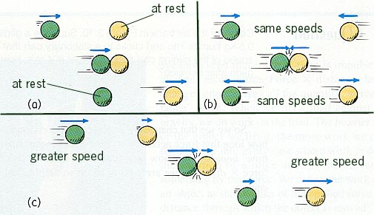
Types of Collisions
A situation where the objects DO NOT STICK is one type of collision
Notice that in EACH case, you have TWO objects BEFORE and AFTER the collision.

Slide 34
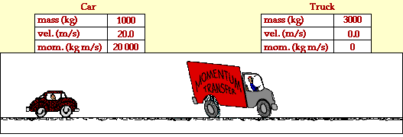
A “no stick” type collision
Σp_{before =}
Σp_{after}
-10 m/s

Slide 35

Types of Collisions
Another type of collision is one where the objects “STICK” together. Notice you have TWO objects before the collision and ONE object after the collision.

Slide 36
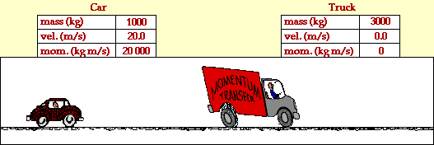
A “stick” type of collision
Σp_{before =}
Σp_{after}
5 m/s

Slide 37
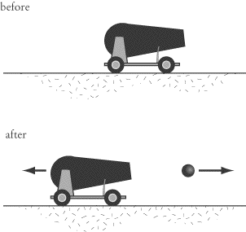
The “explosion” type
This type is often referred to as “backwards inelastic”. Notice you have ONE object ( we treat this as a SYSTEM) before the explosion and TWO objects after the explosion.

Slide 38
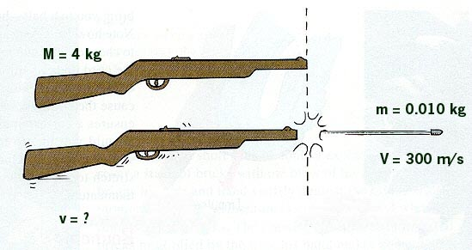
Backwards Inelastic - Explosions
Suppose we have a 4-kg rifle loaded with a 0.010 kg bullet. When the rifle is fired the bullet exits the barrel with a velocity of 300 m/s. How fast does the gun RECOIL backwards?
Σp_{before =}
Σp_{after}
-0.75 m/s

Slide 39
Collision Summary
Sometimes objects stick together or blow apart. In this case, momentum is ALWAYS conserved.
When 2 objects collide and DON’T stick
When 2 objects collide and stick together
When 1 object breaks into 2 objects
Elastic Collision = Kinetic Energy is Conserved
Inelastic Collision = Kinetic Energy is NOT Conserved

Slide 40
Elastic Collision
Since KINETIC ENERGY is conserved during the collision we call this an ELASTIC COLLISION.

Slide 41
Inelastic Collision
Since KINETIC ENERGY was NOT conserved during the collision we call this an INELASTIC COLLISION.

Slide 42
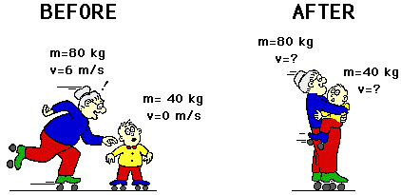
Example
Granny (m=80 kg) whizzes around the rink with a velocity of 6 m/s. She suddenly collides with Ambrose (m=40 kg) who is at rest directly in her path. Rather than knock him over, she picks him up and continues in motion without "braking." Determine the velocity of Granny and Ambrose.
How many objects do I have before the collision?
How many objects do I have after the collision?
2
1
4 m/s

Slide 43

Name of Course: Engineering Mechanics
Course code: 216U06C104
Module 5: Kinetics of particles
Lecture 8: Impulse Momentum Principle

Slide 44

Learning Outcomes
Lect 41: At the end of lecture learner will be able to apply impulse momentum principle to bodies getting impact.

Slide 45
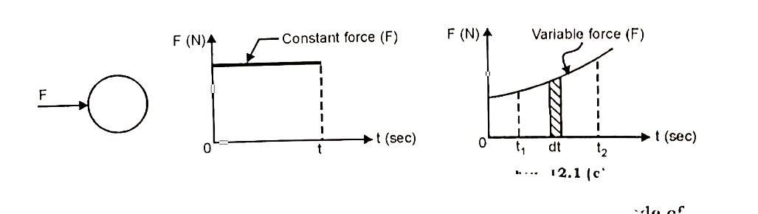
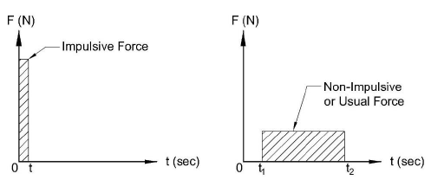
Impulse
Impulsive Force: A large force when acts for a very small time and which causes a considerable change in a particle’s momentum is called an impulsive force.

Slide 46
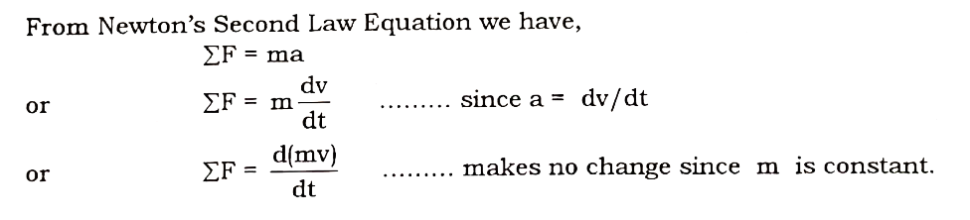
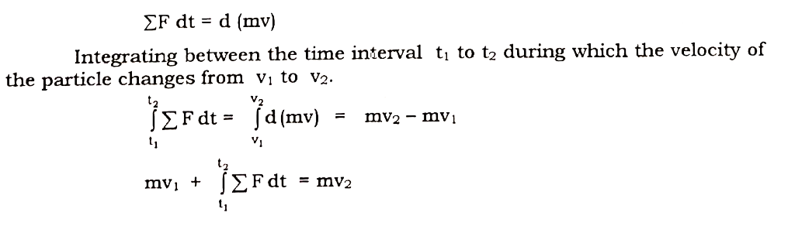
Impulse momentum Equation

Slide 47
Numerical on Impulse momentum principle
Q. 1 A block of mass 50 kg is placed on a plane inclined at 30⁰ with the horizontal. A horizontal force of 250 N acts on the block tending to move down the plane. Determine its velocity 4 sec after starting from rest. Take μ_{k} = 0.3.

Slide 48
Q. 2 A 630 gm cricket ball strikes the bat with a speed of 108 kmph and is hit back by batsman with a speed of 144 kmph. If the ball was in contact with the bat for 72 milliseconds. Determine the average impulsive force exerted on the ball. 612N

Slide 49
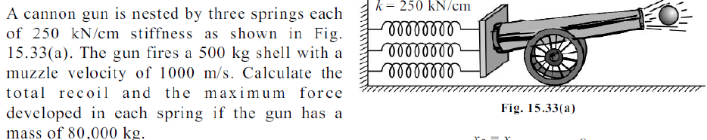
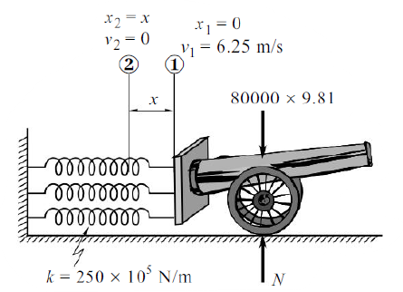
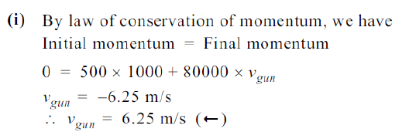

Slide 50
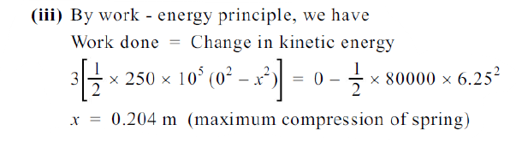
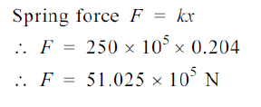

Slide 51
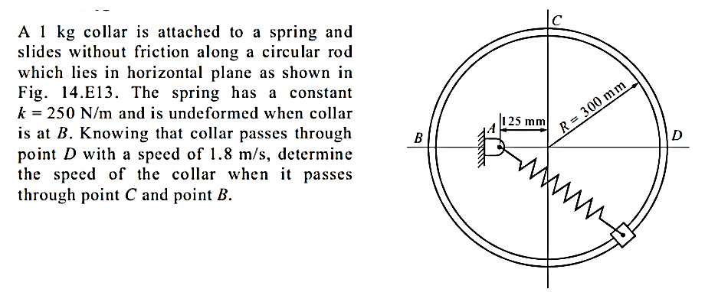
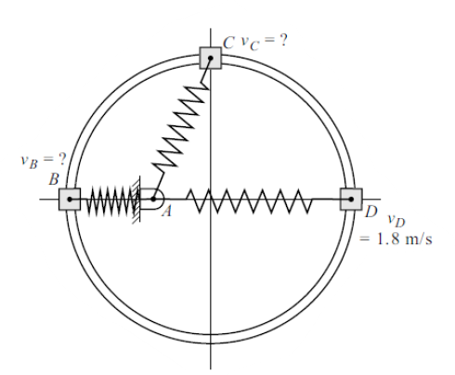
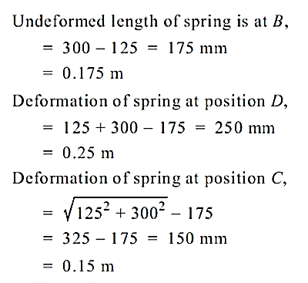

Slide 52
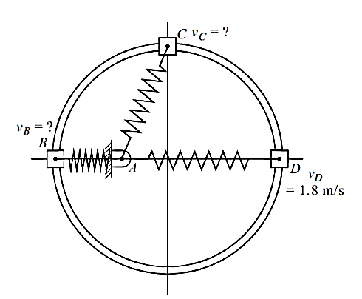
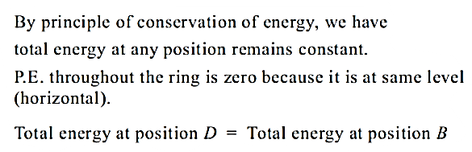
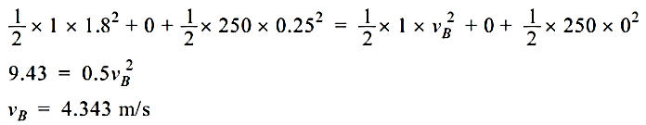
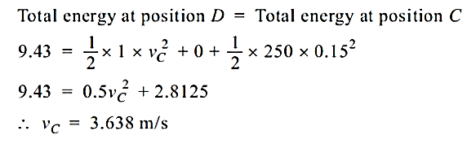

Slide 53
References
Engineering Mechanics, N. H. Dubey, Mc Graw Hill Education (India) Pvt. Ltd.
Engineering Mechanics, M. D. Dayal, page no. 41 to 55.

